Slide 1

FRC Entrepreneurship
TEAM 2080

Slide 2
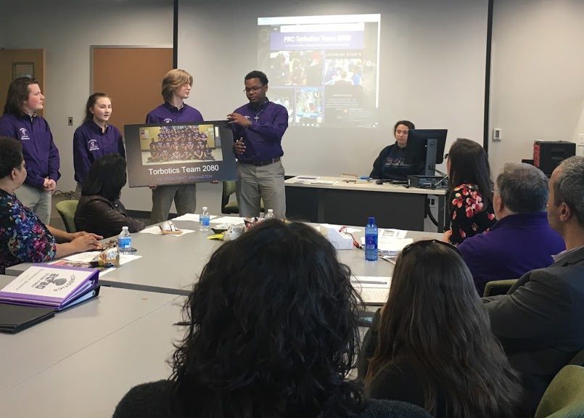
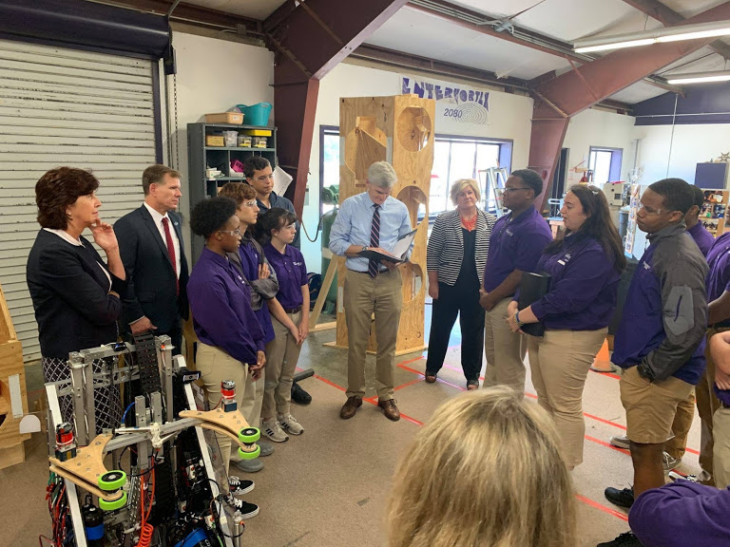
Why is entrepreneurship important?
No team can exist solely on its own. We are all part of a larger community & region. We must learn how to run our team like a business to sustain financially and grow support.
FIRST’s mission centers on the recognition that we #BuildBetterTogether. It’s important to build strong, supportive relationships within your team & with those in your community.
How do you want to be known by your community?
Having a well thought out plan for running your team is vital to ensure your program becomes self-sustaining, builds a clear identity, & overall enthusiasm.

Slide 3
What does successful entrepreneurship look like?
At the beginning of each season (prior to game release), teams should sit down and analyze what was successful and not from the previous season. This is a great way to help review prior procedures & protocol & to give input to make changes.
A successful business plan is one that truly represents your team & becomes a resource when going out to engage your community. It should include the team’s mission, vision & defined goals & how you manage & track progress toward achieving your ongoing objectives.
Successful entrepreneurship involves selling your team as a product worthy of investment.
What would companies have to gain by helping you?
What would companies get in return?
Set up ways to reward your sponsors. (Ex: company logo recognition on your team’s sponsor banner, published materials, season shirt, robot decal, etc.)

Slide 4
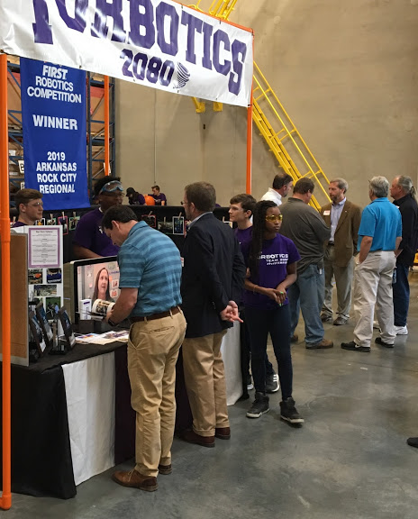
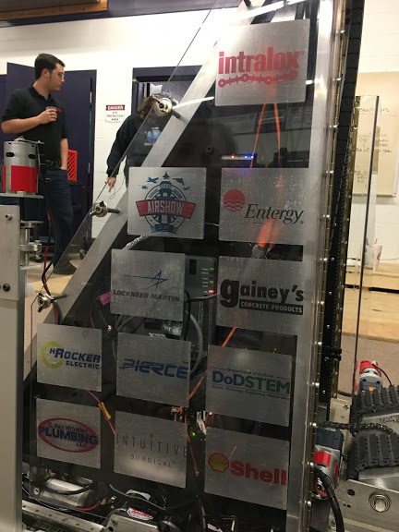
Engaging Sponsors
To engage potential sponsors you will need:
Confidence
Tell them the WWE
Confidence
Be calm, collected & most importantly yourself.
Have a good foundation/outline of what you want to say.
-Have talking points involving your mission
-Plan an opening statement to get going.
For practice, have someone ask you questions sponsors might ask.
WWE
Why should they sponsor your team?
What will they gain in sponsoring your team?
What is your End goal?

Slide 5
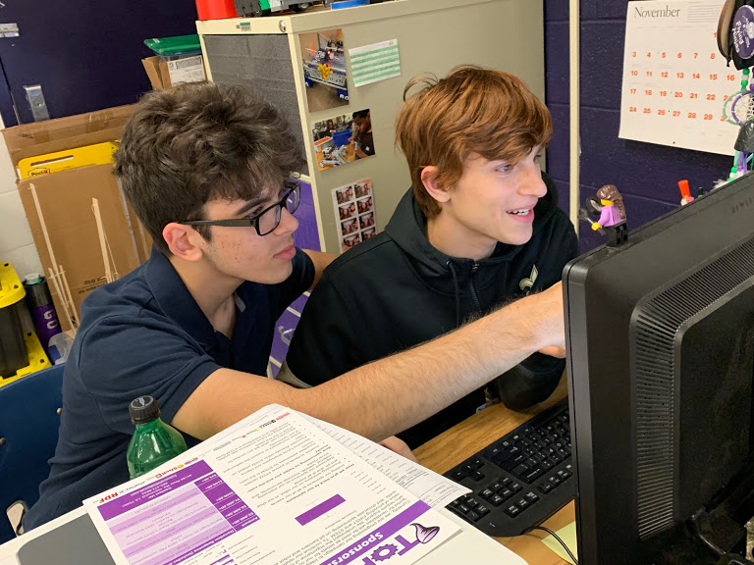
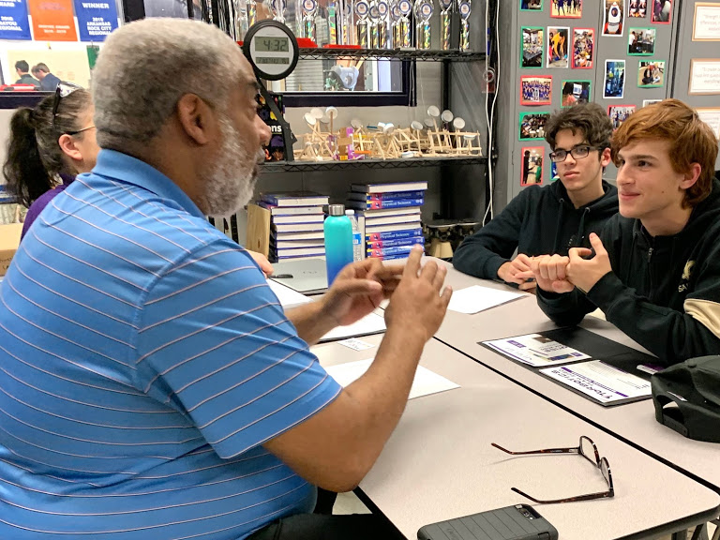
Tracking & Reporting Metrics
Why is it important to track team stats?
To provide concrete data to your current & potential sponsors
-It better informs their investment.
It allows future members a better understanding of the team’s history.
It allows you to gauge team progress in completing both long & short term initiatives & make more informed decisions when planning the team’s sustainability.
It helps instill a sense of accountability throughout the team.
It helps you to better define the team’s strengths & areas of improvement.

Slide 6
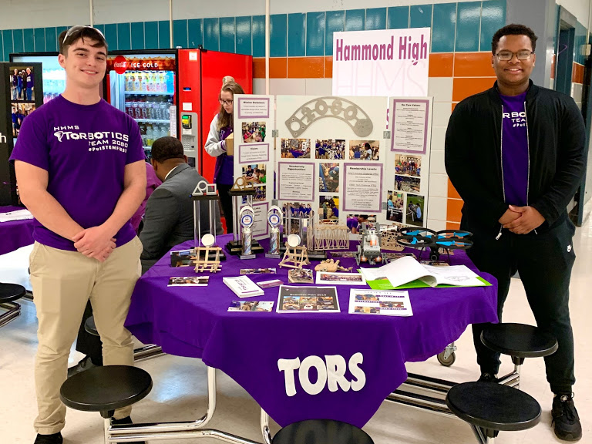
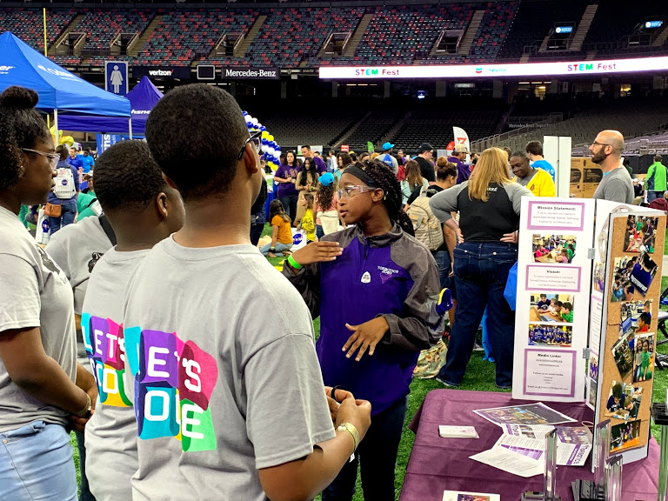
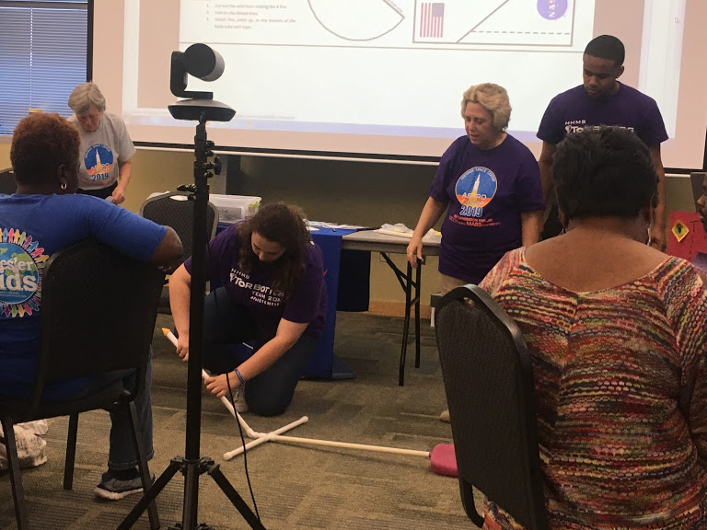
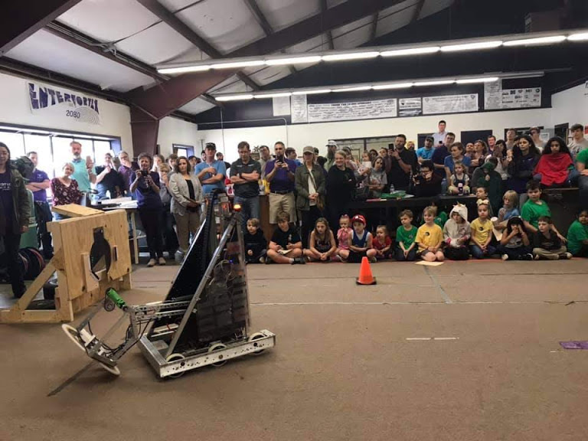
Tracking & Reporting Metrics
What to record:
Income/Expenses
Events (attendance & survey data/participant feedback).
Team demographics & progress on team initiatives.
Information on sponsors
Data on marketing effectiveness.

Slide 7
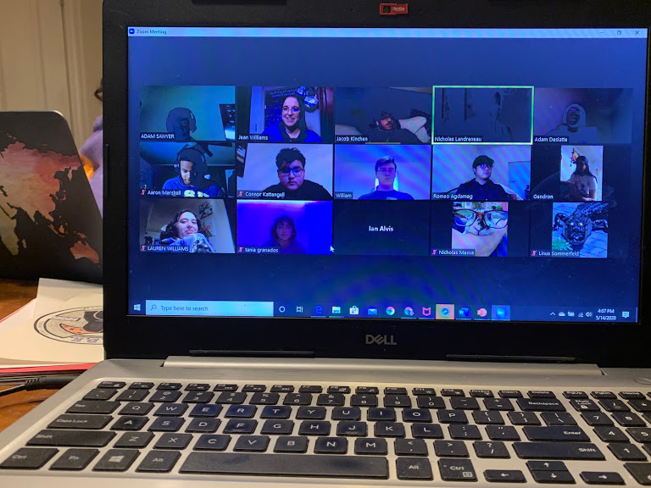
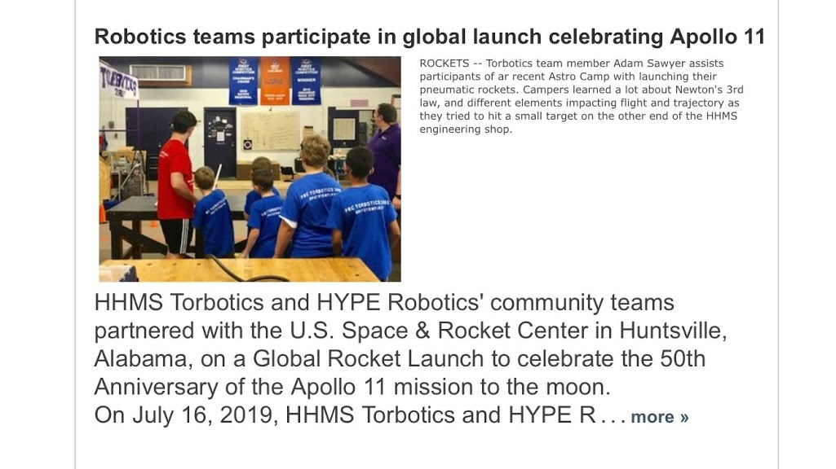
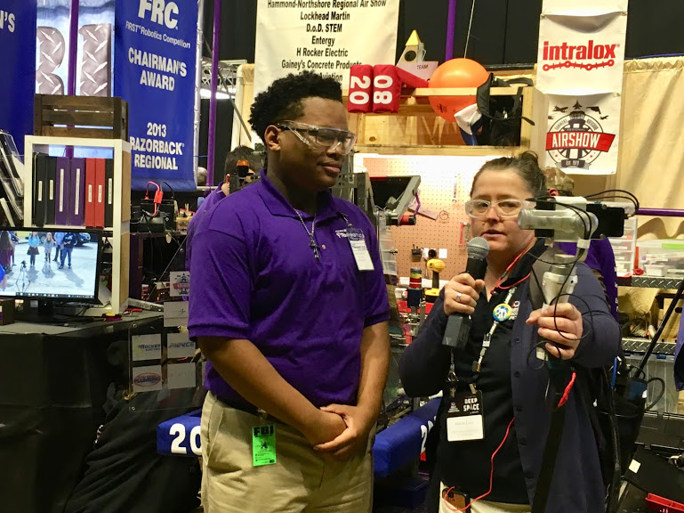
Focus on Marketing
To market successfully, you need a strategy:
How will you put your team out there?
Face-to-Face vs. Online Marketing
Face-to-Face Marketing
Make flyers, brochures, business cards, or any other media to hand to businesses.
Meet & develop a relationship with individuals at local businesses.
Become a fixture at local events.
Online Marketing
Make a Website (Google Sites or another site can aid in creating a website)
Regular social media (All platforms)
Newspaper articles
Live & recorded radio slots

Slide 8
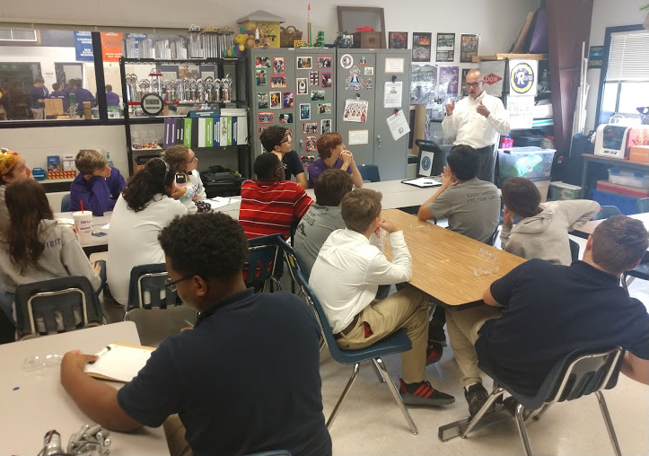
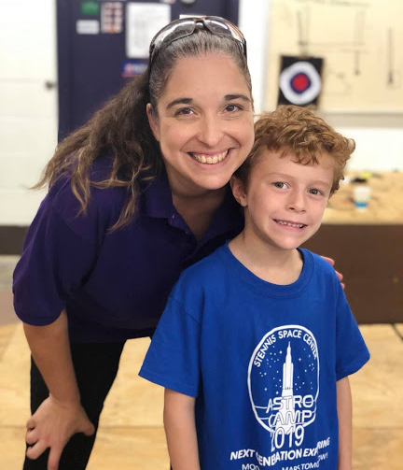
Tips for Team Implementation
Reach out into the business community to learn more about marketing & developing a strong business plan.
We’ve had the head of our local Small Business Development Center speak with us & provide feedback on existing marketing materials.
The purpose of everything you create should be to engage sponsors & community support, not for the sole aim of winning an award. Your plan will be more meaningful if it serves a tangible purpose & engages the entire team.

Slide 9
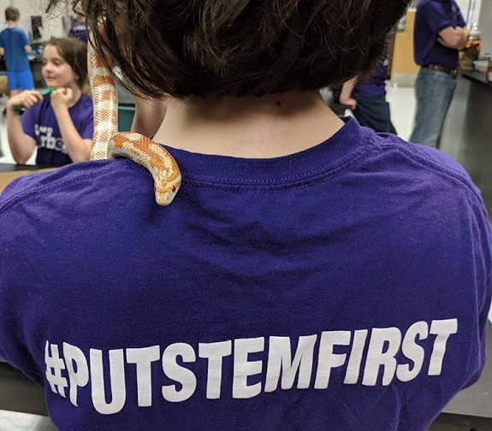
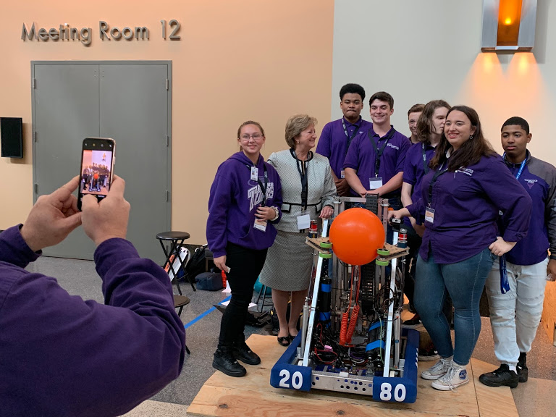
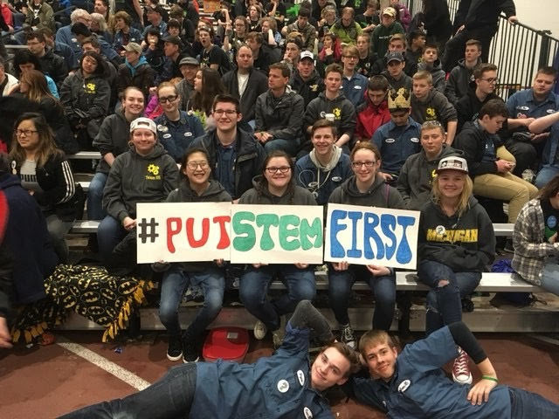
Tips for Team Implementation
Keep your mission simple & relatable. Your vision should represent who you are & what you envision for your community. Our mission is summed up in 3 words: #PutSTEMFIRST.
Make sure the ongoing development of your plan is part of weekly meetings so everyone is aware of progress & gives input.
Your sponsors are your constituents. You want their input as well.

Slide 10
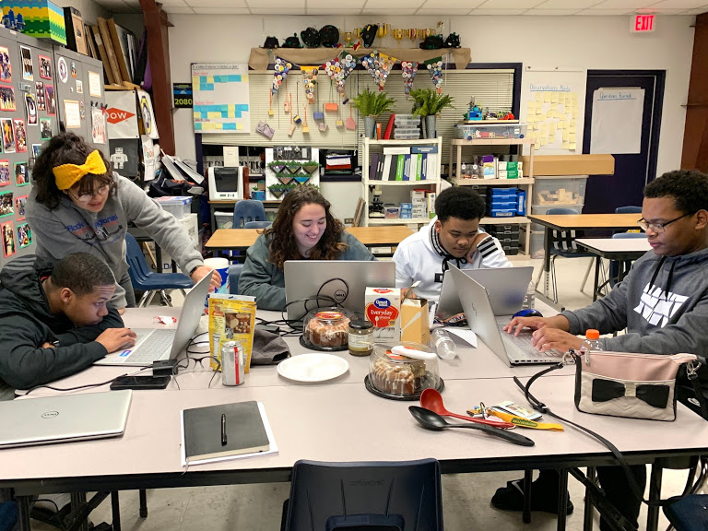
Entrepreneurship Judging: What to Expect
Prior to the event, work with your team to develop some main talking points. How do you think your team stands out?
You will turn in your business plan once you get to your event. Make sure to follow the award guidelines for this each year.
Know your team stats & be prepared to create an open dialogue with judges.
Look for clear ways to graphically sum up your key points to include in your business plan. These will be a great reference point.

Slide 11
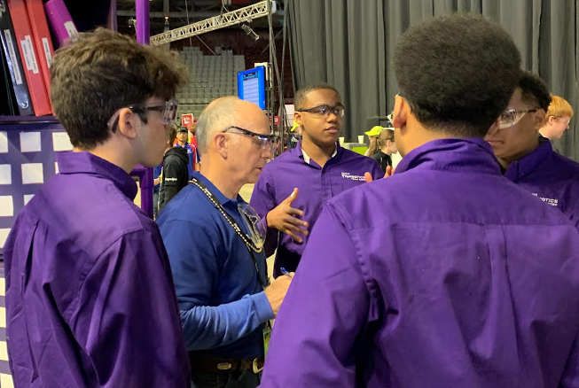
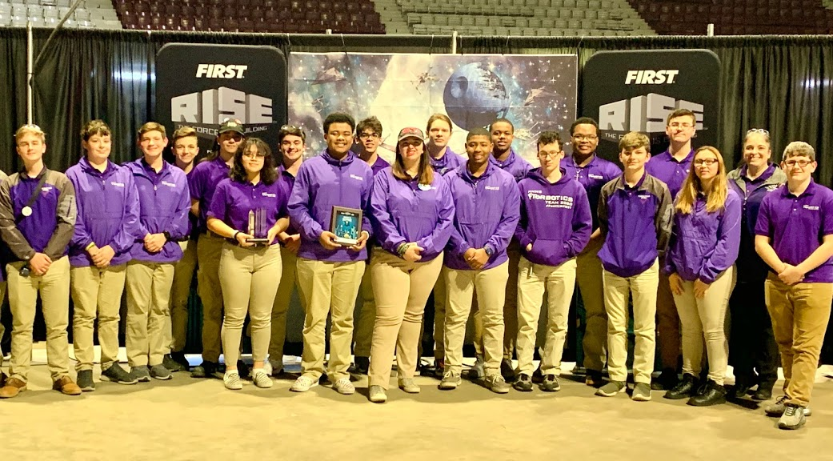
Entrepreneurship Judging: What to Expect
Make sure you can answer the following:
How is your business plan organized?
How does your team make decisions & divide the workload?
How does your team retain active engagement from students, mentors, and sponsors?
How do you recruit & train new members & keep from losing team knowledge/skills as seniors graduate?
How does your team celebrate successes & document lessons learned to keep from making repeated mistakes?

Slide 12

Credits
This lesson was written by FRC 2080 for FRCTutorials.com
You can contact the author at frcteam2080@gmail.com or www.torbotics2080.org
More lessons for FIRST Robotics Competition are available at www.FRCtutorials.com
This work is licensed under a
Creative Commons Attribution-NonCommercial-ShareAlike 4.0 International License.

